Slide 1
Data Analytics for Petroleum Engineers …How to Kickstart as a student
Praise Ekeopara

Slide 2
OUTLINE
Introduction to Data Analytics
Data Analytics Workflow
Industrial Applications of Data Analytics
Roadmap for Learning Data Analytics – 6 months
Platforms for Learning Data Analytics
Secrets for Speed in Learning
Conclusion
Q & A

Slide 3
Introduction to Data Analytics
Data Analytics
Programming
Statistics
BI Tools
Domain Knowledge
Mathematics
Machine Learning
Data
Data
Data
Data
Data
Data
Data
Data
Data
Data
Data
What is Data Analytics ?
Data analytics is the use of practical skills for the collection, cleaning, transformation, and modeling of data to discover useful information that can be used to make recommendations for future decisions.

Slide 4
Data Analytics Workflow
… Everyday Analytics Job
Define
the objective
Clean the Data
Find Insight and visualize
Learn and Improve
1
2
3
4
5
6
7
Collect the data
Enrich the data
Deploy Machine Learning

Slide 5
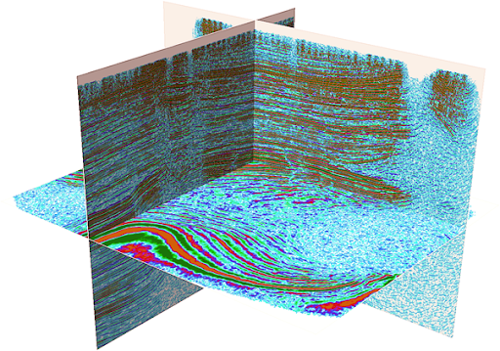
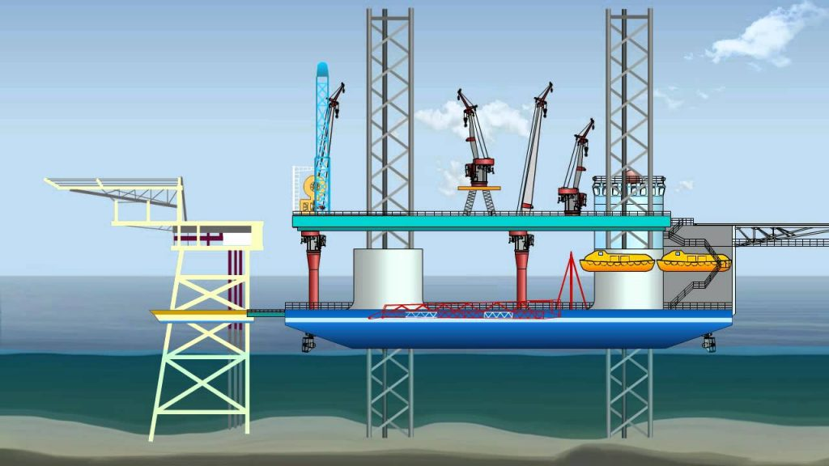
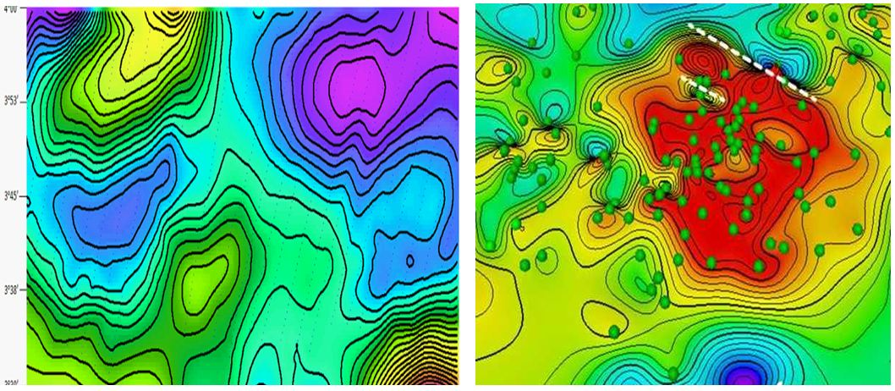
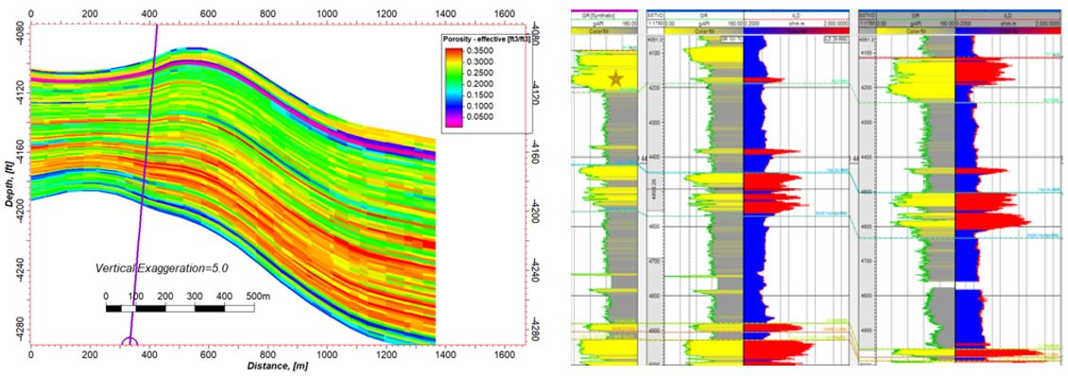
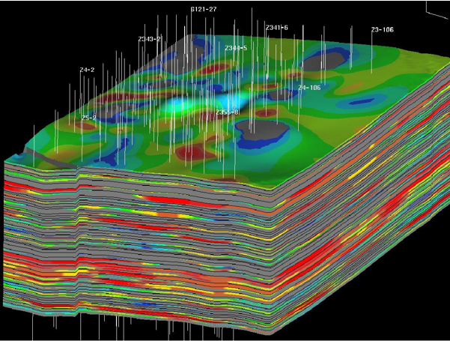
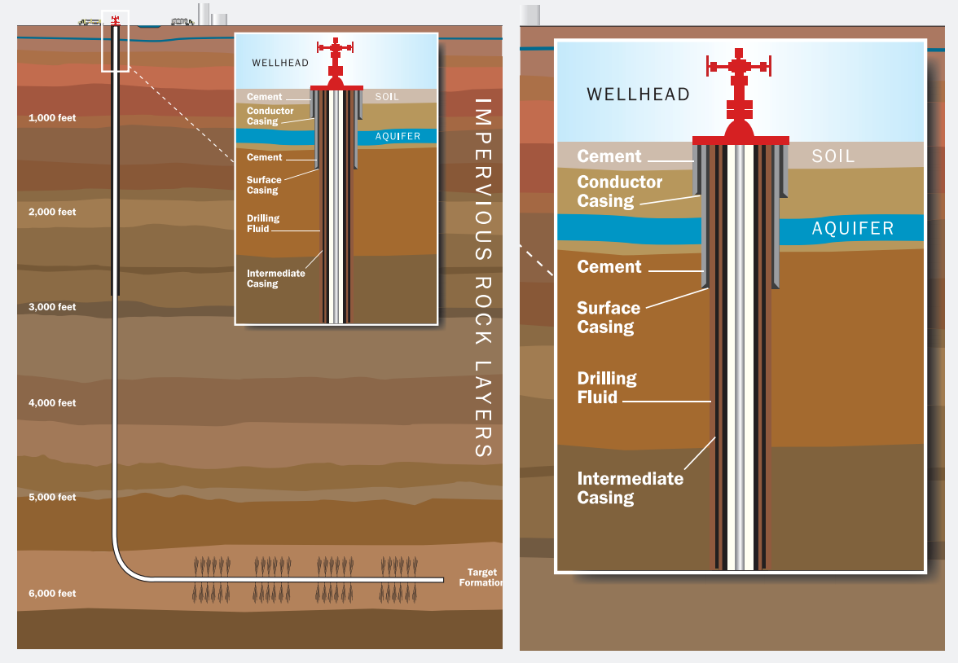
Industrial Applications of Data Analytics
Seismic Processing
13 to 2.5 months reduction
Well Intervention
80% reduction
Structural Interpretation
1/5 reduction
Field Development Planning
14x | 3X
Well Construction
½ reduction
Simulation
120 days to 3 days
Info source: Schlumberger
Image source: Google

Slide 6
Roadmap for Learning Data Analytics
6
MONTHS PLAN
Excel + Statistics
Basics to intermediate level
Machine Learning (Regression)
Algorithms and implementations
SQL & Databases
Basic to intermediate level
Never Stop Learning !
1
3
5
2
4
6
Machine Learning (Classification)
Algorithms and implementations
BI Tools
-PowerBi
- Tableau
Programming (Python & R)
- Python basics
- Python for data analyisi

Slide 7









Platforms for Learning Data Analytics
FREE/PAID
7

Slide 8
Secrets for Speed in Learning
01
Mentorship
Have a mentor, who will guide you and answer your questions
04
Teach Others
Share what you have learnt with others. Post and publish.
02
Projects
Never skip any project while learning
05
Network
Networking is key. Engage with others
03
Experience
Build your experience level. Take internships, engage
06
Consistently Learn
To become an expert, you must never stop learning

Slide 9
Conclusion
The GOAL is to turn DATA into INFORMATION and information into INSIGHT.
Carly Fiorina

Slide 10
THANKS!
Q & A ?

